Slide 1
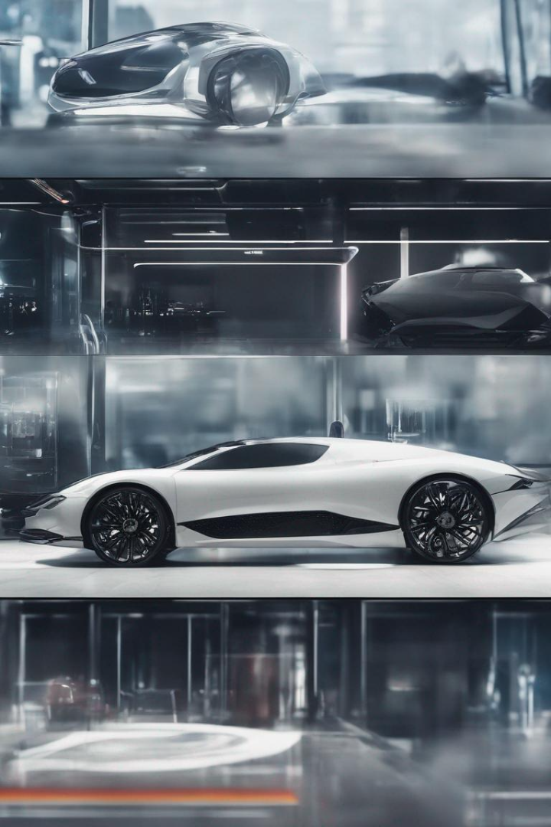
Car Parking Reservation System Project in C++
Welcome to our presentation on the Car Parking Reservation System project developed using C++. Explore the purpose, design, implementation, testing, and future enhancements of this system.

Slide 2

Introduction
The Car Parking Reservation System project aims to provide an efficient solution for managing and reserving parking spaces. Discover the importance of this system in today's urban environment.

Slide 3
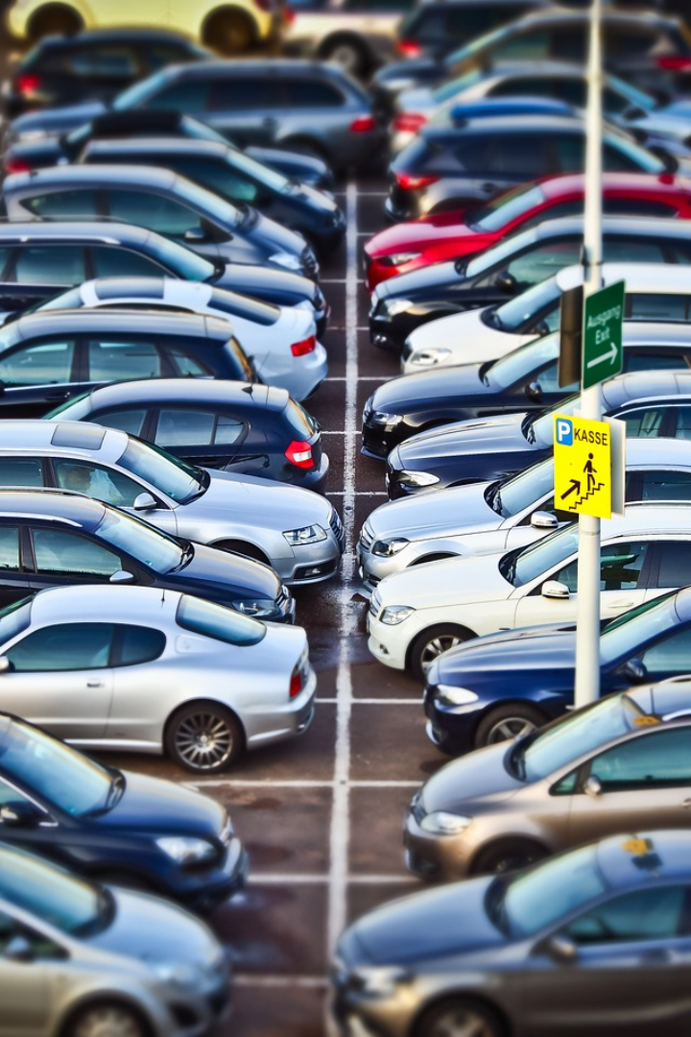
Purpose
The purpose of a car parking reservation system is to optimize the use of parking spaces, provide a convenient experience for users, and streamline parking management for businesses and organizations. Key benefits of a car parking reservation system include:
Time-saving
Contactless convenience
Efficient parking management
Optimized car park usage
Reduced stress
Scalability

Slide 4

Requirements Gathering
Identifying Needs
Gathering User Requirements
Thoroughly analyze the requirements of the system to ensure all aspects of a parking reservation system are covered.
Engage with potential users to understand their specific parking needs and incorporate them into the system design.

Slide 5
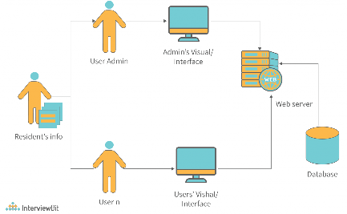
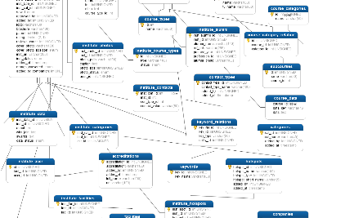
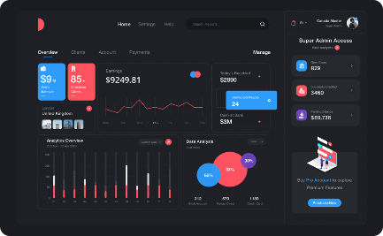
System Design
Architecture Design
Database Structure
User Interface Design
Create a robust and scalable system architecture that efficiently handles parking reservations and related operations.
Design an optimized database structure to store parking lot information, user data, and reservation details.
Create an intuitive and user-friendly interface to allow easy reservation and management of parking spaces.

Slide 6

Implementation
1
Coding the System
2
Integration with Libraries
Use features of OOPS in C++ to implement the Car Parking Reservation System, ensuring efficient and reliable functionality.
iostream
fstream
string
ctime
conio.h

Slide 7
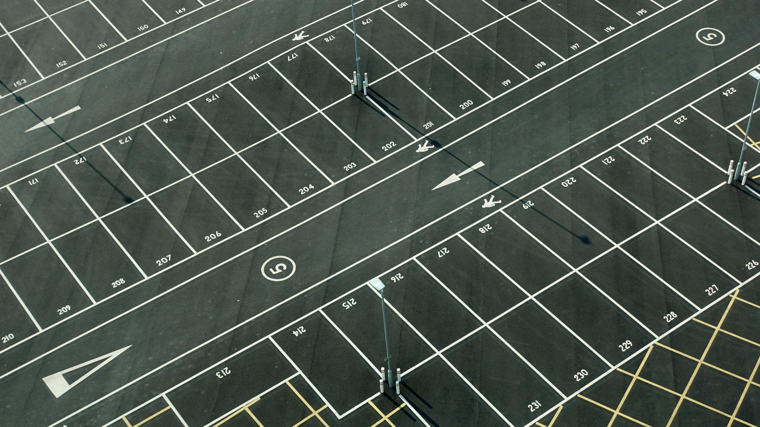
Features of OOPS used in project
Classes and Objects
File handling
Encapsulation
Abstraction
Association and Aggregation
Inheritance

Slide 8



Functionalities & Project Overview
Module
User Side Functionality
Admin Side Functionality
User details
Book Parking Slot
Slots Booked
Parking Availability Check
Cancellation
View User Data
Parking Booking Online for Date & Time
Payment
Cancellation
Automatic Cost Calculation
Parking cancellation

Slide 9
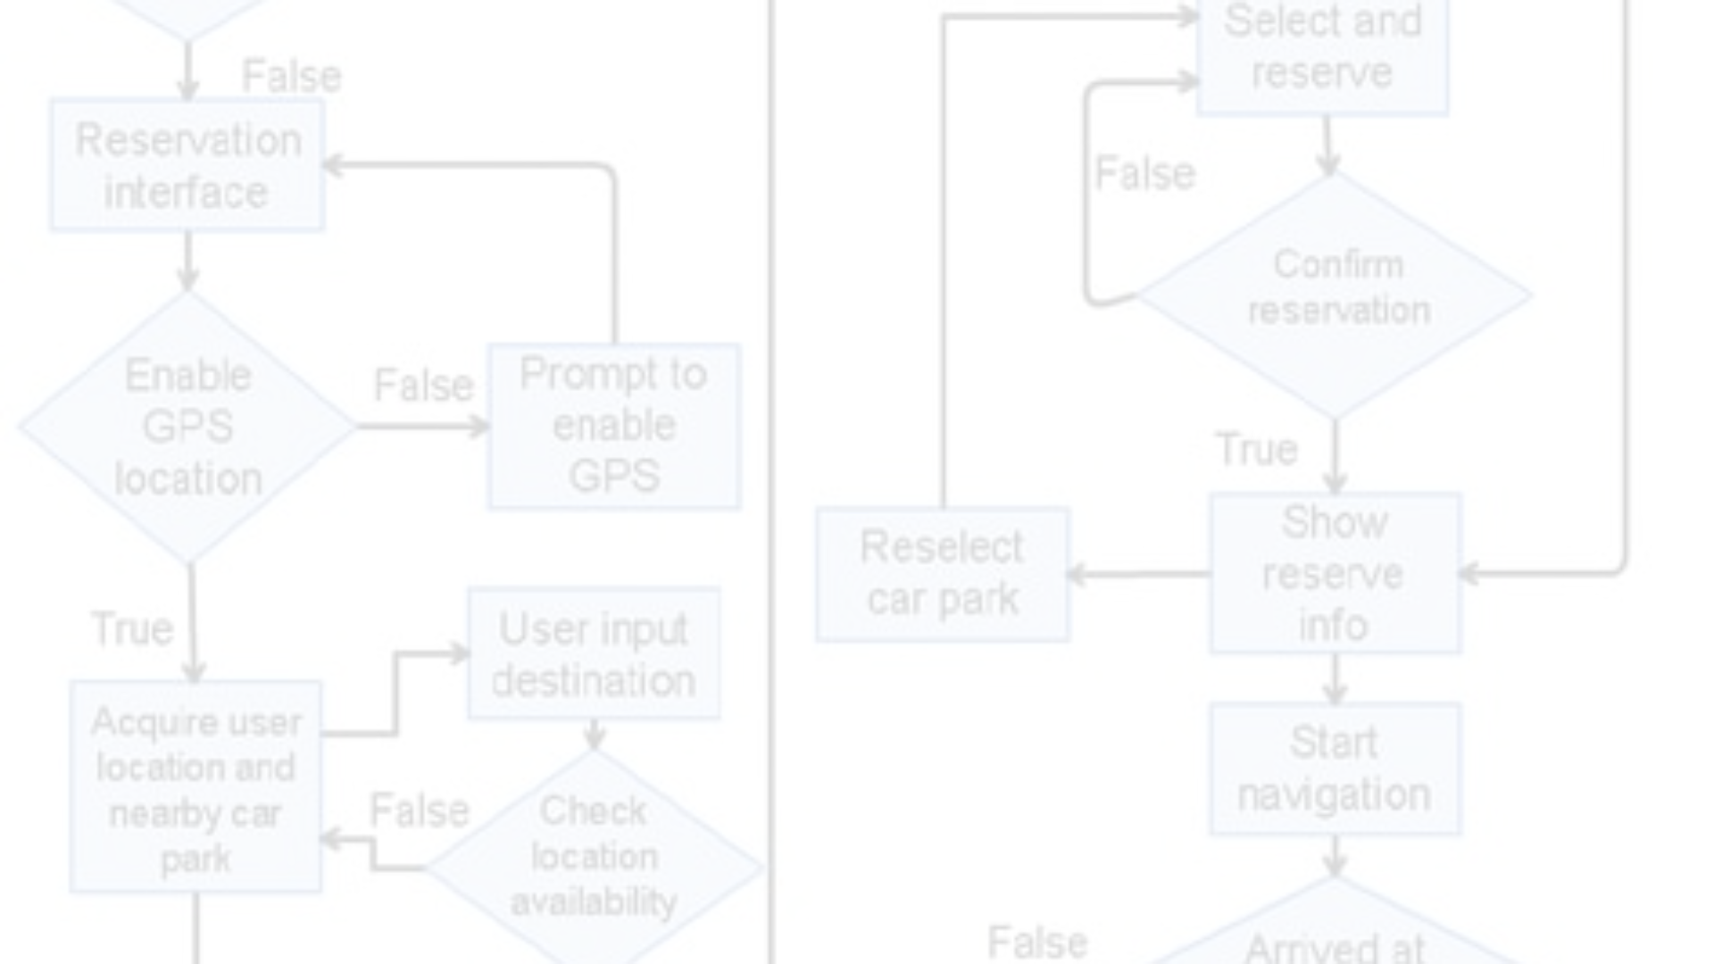
Testing and Validation
1
Designing Test Cases
Create a comprehensive set of test cases to cover all possible scenarios and ensure system reliability.
2
Unit and System Testing
Conduct thorough unit testing and system testing to identify and resolve any bugs and errors in the system.
3
Meeting Requirements
Ensure that the Car Parking Reservation System fulfills all the specified requirements effectively and efficiently.

Slide 10
OUTPUT:-
====== CAR PARKING RESERVATION SYSTEM ======
1. Reservation of Parking space
2. Total no of Parking spots reserved
3. Parking charges a car with details
4. Total parking charges of all cars with details
5. Cancellation of Reservation of a car
6. Exit Program
======================
LOGIN DETAILS
Car Parking Reservation System Login Enter Password: **** Access Granted! Welcome To Our System Press any key to continue . . .
Select Your Choice ::2
=== View the Records in the Parking Reservation Database ===
The Car position in parking lot : 1
The Driver Name : Alice
The Car No : 106
The Hours Of Stay : 3
The date of Parking : 20/11/2023
The Time Slot Of Parking : 10:00
The time and date of reservation : 2023-11-17 10:13:16
Press any key to continue . . .
The Car position in parking lot : 2
The Driver Name : Bob
The Car No : 105
The Hours Of Stay : 2
The date of Parking : 18/11/2023
The Time Slot Of Parking : 12:00
The time and date of reservation : 2023-11-17 10:13:48
Press any key to continue . . .
Select Your Choice ::1
==Do You Want to continue==y/n y
Enter the name of driver : Harshitha
Enter the car no : 300
Enter the no of hours of stay : 6
Enter the date of reservation (dd/mm/yyyy) (choose from 18/11/2023 to 18/12/2023) : 17/12/2023
Enter the time slot (choose between 06:00 - 22:00) : 10:00
Parking Available! Your paring slot has been reserved.

Slide 11
Select Your Choice ::4
The Driver Name : Alice
The Car No : 106
The Hours Of Stay : 3
The date of Parking : 20/11/2023
The Time Slot Of Parking : 10:00
The time and date of reservation : 2023-11-17 10:13:16
Are you a V.I.P: y/n y
The total expense during parking 60 rupees
The Driver Name : Bob
The Car No : 105
The Hours Of Stay : 2
The date of Parking : 18/11/2023
The Time Slot Of Parking : 12:00
The time and date of reservation : 2023-11-17 10:13:48
Are you a V.I.P: y/n n
The total expenses during parking 50 rupees
Select Your Choice ::3
Car number to search for : 267
The Driver Name : Judith
The Car No : 267
The Hours Of Stay : 6
The date of Parking : 19/11/2023
The Time Slot Of Parking : 07:00
The time and date of reservation : 2023-11-17 10:21:53
Are you a V.I.P: y/n n
The total expenses during parking are 150 rupees
Select Your Choice ::5
Enter the car no you want to cancel reservation : 105
Reservation cancelled.
Select Your Choice ::6
Thank you

Slide 12

Conclusion and Future Enhancements
Reflect on the successful development of the Car Parking Reservation System project and discuss potential future enhancements to further improve its functionality and user experience.

